Slide 1
Introduction to computer vision
Jean Ponce and Elena Sizikova
jean.ponce@inria.fr, es5223@nyu.edu
Manjusha Mishra and Aryaa Singh
mam1974@nyu.edu, as13538@nyu.edu
Slides will be available after classes
See logistic details at the end

Slide 2
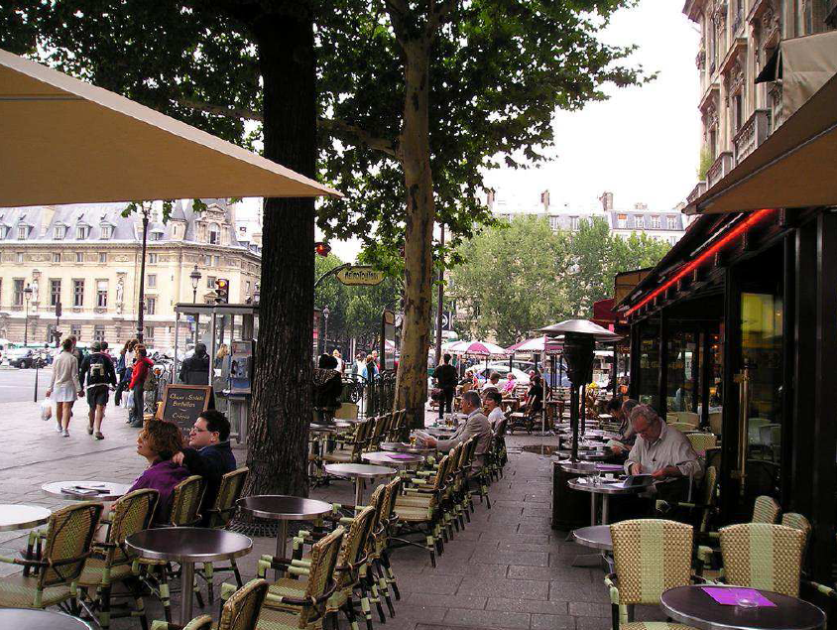
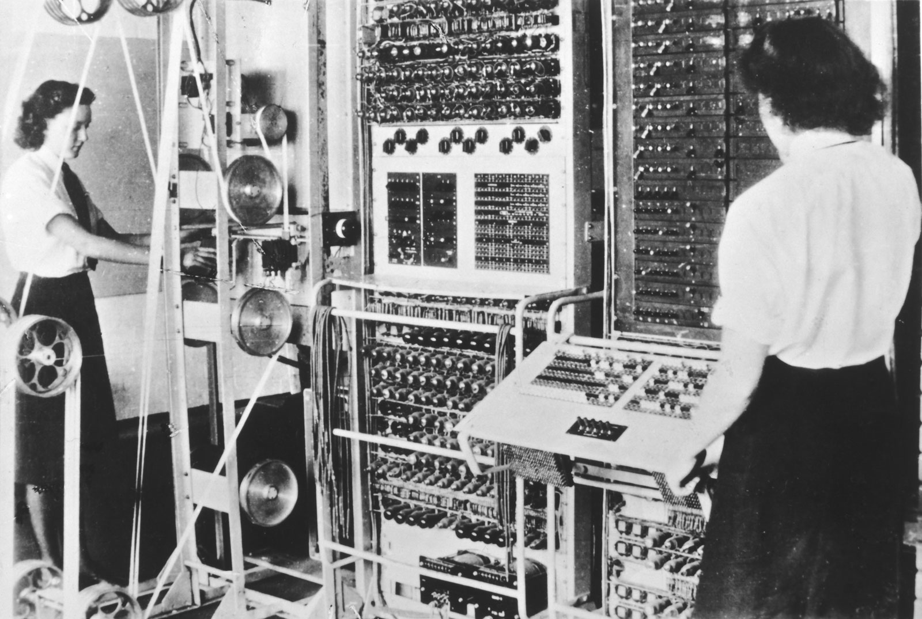
Description:
Street scene
Bar
Chairs
People drinking coffee
Ashtray, etc.
Notes:
2

Slide 3

Computer vision
… extracting information from images and video
(courtesy of I. Laptev)
Notes:
Goals: Interpret static and dynamic visual scenes
Recognize objects, people, human actions, scene geometry, …

Slide 4
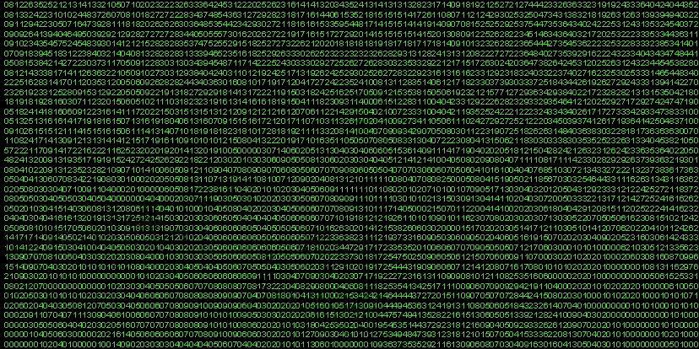
Vision is hard—this is what the machine “sees”
The visual cortex is about 50% of the macaque brain
More human brain is dedicated to vision than anything else

Slide 5
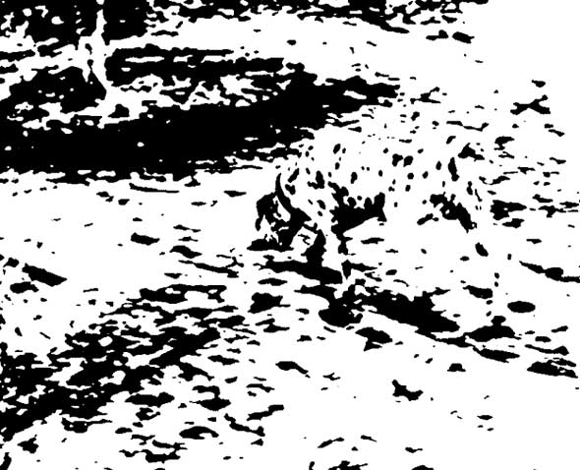

Slide 6
WHY IS VISION DIFFICULT ?
Too much information:
1000x1000x24 bits 30 times per second;
matching n features against n features costs n!;
shadows, highlights, texture..
Too little information:
Physical properties (depth, orientation, reflectance..)
of the world are not directly observable.
What are appropriate models?
of images, object instances, object classes, video
content and the interpretation process..
What are appropriate algorithms and architectures?

Slide 7
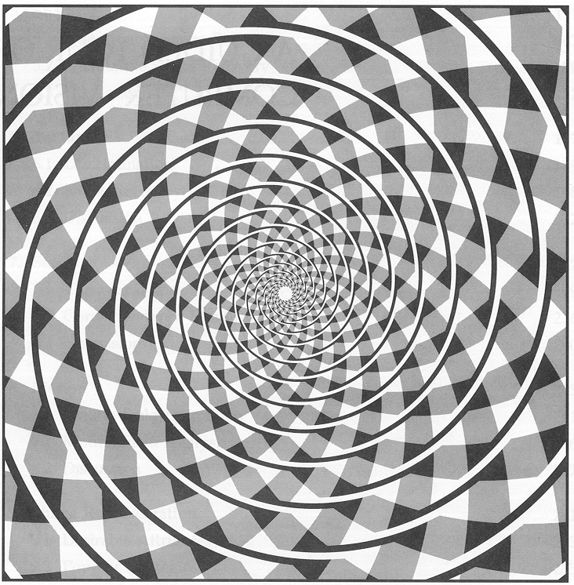
(Nalwa, 1993)

Slide 8
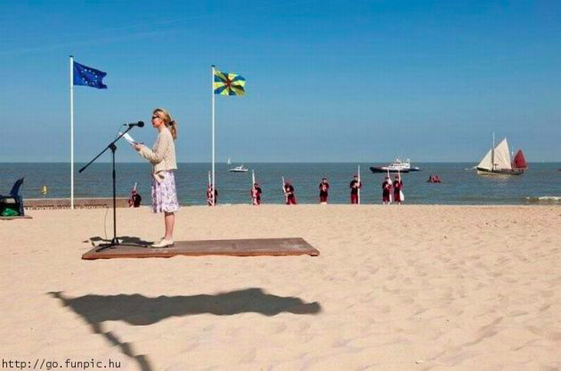
J.J. Koenderink, www.gestaltrevision.be/en/resources/clootcrans-press

Slide 9
COMPUTER VISION IS INTERESTING.
We know it is possible.
We know it is difficult.
We don’t (really) know how to do it.
(Next three slides and many others courtesy of Jan Koenderink.)

Slide 10
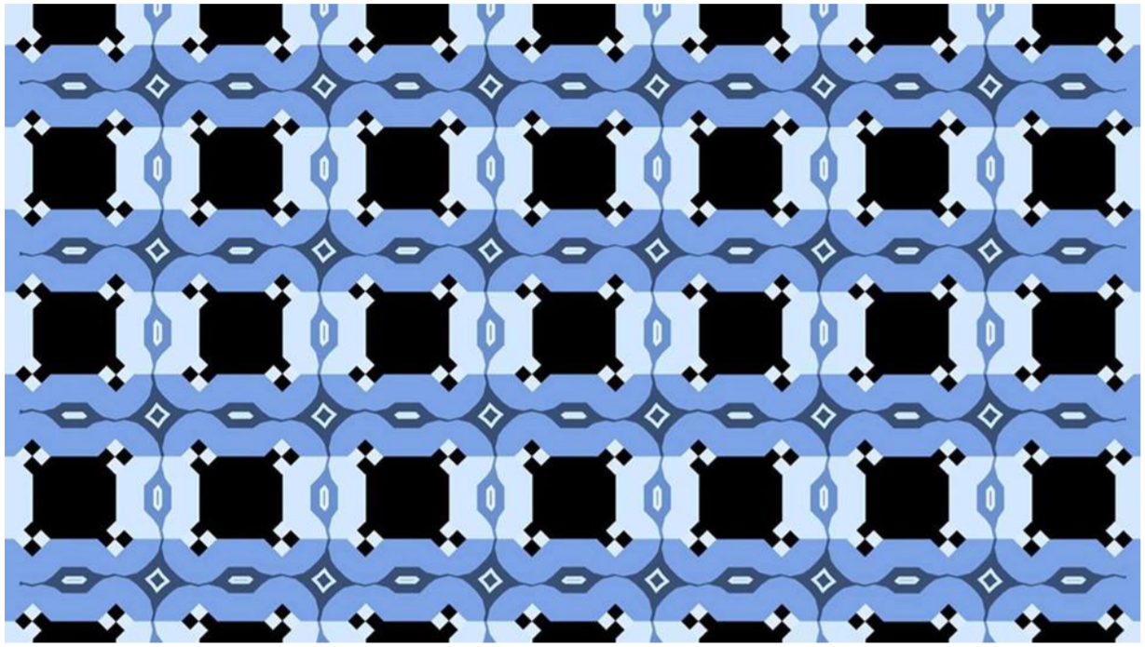
(Victoria Skye)

Slide 11
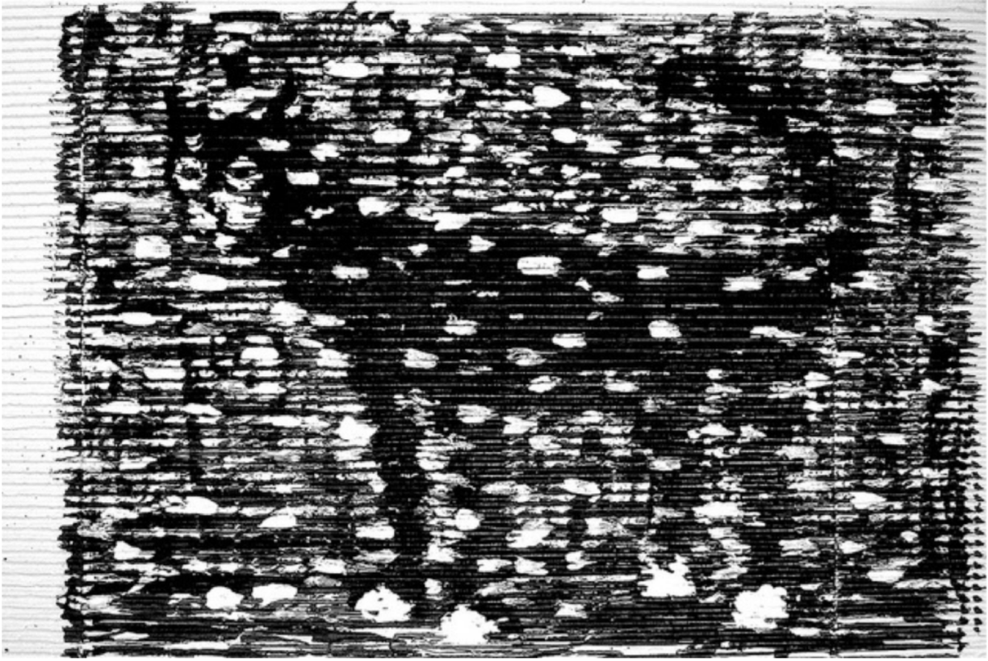
(Franco Mattichio)

Slide 12
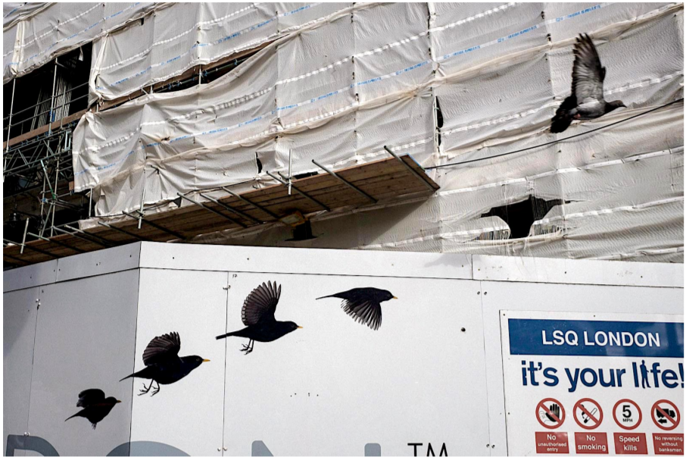
(Pau Buscato)

Slide 13
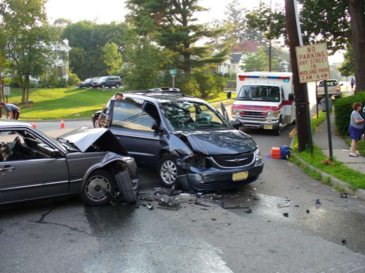
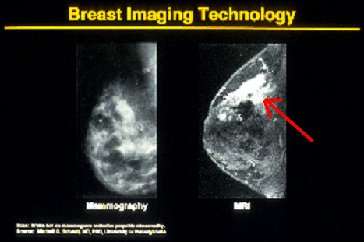

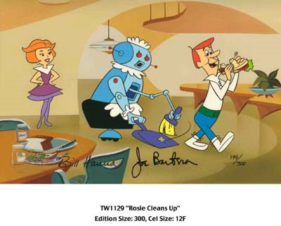
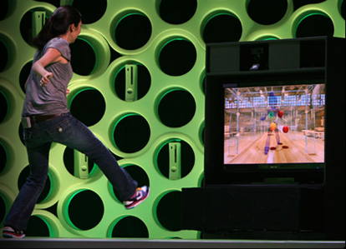

Why computer vision matters
Safety
Health
Security
Comfort
Fun
Access

Slide 14
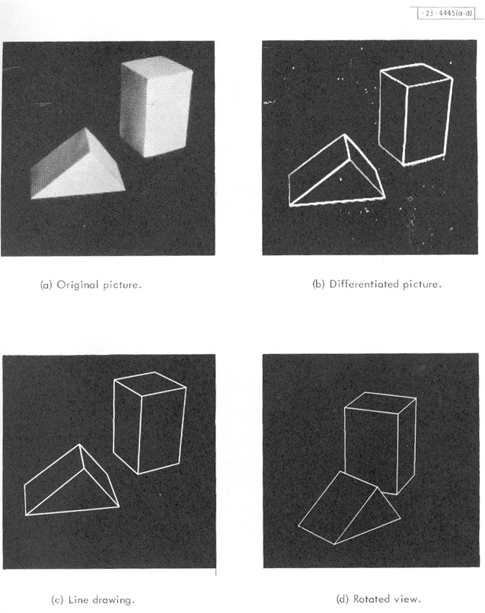
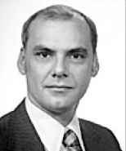
Origins of computer vision
L. G. Roberts, Machine Perception of Three Dimensional Solids, Ph.D. thesis, MIT Department of Electrical Engineering, 1963.
photo credit: Joe Mundy

Slide 15
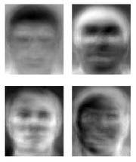
After Roberts: a ridiculously brief history of computer vision
1966: Minsky assigns computer vision as an undergrad summer project (??)
1960’s: interpretation of extremely simple images & synthetic worlds
1970’s: some progress on interpreting selected images
1980’s: ANNs come and go; shift toward geometry and increased mathematical rigor
1990’s: face recognition; statistical analysis
2000’s: broader recognition; large annotated datasets available; video processing starts
2010’s: Deep learning with ConvNets
2030’s: …
Guzman ‘68
Ohta Kanade ‘78
Turk and Pentland ‘91
Notes:
“In 1966, Minsky hired a first-year undergraduate student and assigned him a problem to solve over the summer: connect a television camera to a computer and get the machine to describe what it sees.” Crevier 1993, pg. 8

Slide 16
WHAT IS COMPUTER VISION GOOD FOR?
Traditionally:
Manufacturing: inspection, bin picking;
Defense: ATR, photogrammetry, surveillance;
Robotics: navigation, visual servoing.
Recently:
Computer graphics, medical imaging, HCI;
3D vision and recognition;
The Web, Internet, social networks;
Robotics again;
And zillions of other industries.
Really:
Understanding the principles of object recognition;
Building the robots of tomorrow, for home and space;
Understanding how people tick;
It is just difficult, fun, and interesting.

Slide 17
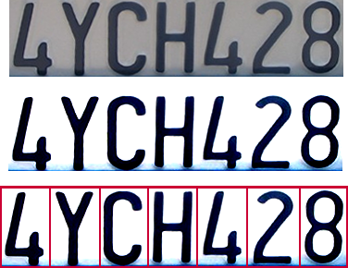

Optical character recognition (OCR)
Technology to convert scanned docs to text
If you have a scanner, it probably came with OCR software
Digit recognition, AT&T labs
http://www.research.att.com/~yann/
License plate readers
http://en.wikipedia.org/wiki/Automatic_number_plate_recognition

Slide 18
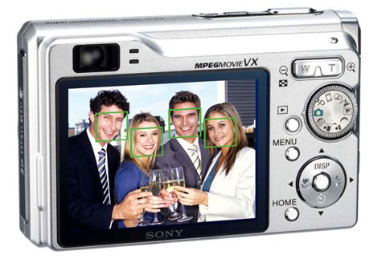
Face detection
Even smile detection
Notes:
Why would this be useful? Main reason is focus. Also enables “smart” cropping.

Slide 19
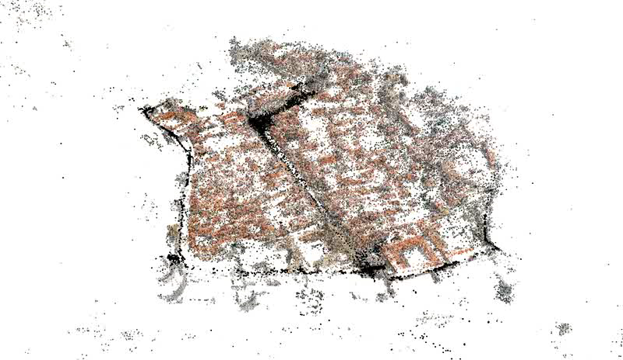
Structure from motion from busloads of images
(Agarwal et al. 2009)

Slide 20
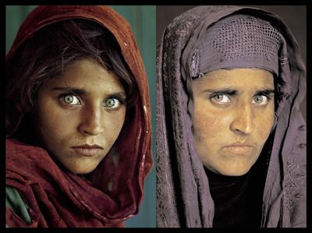
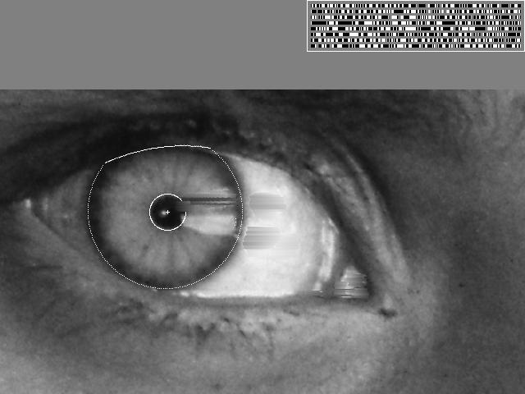
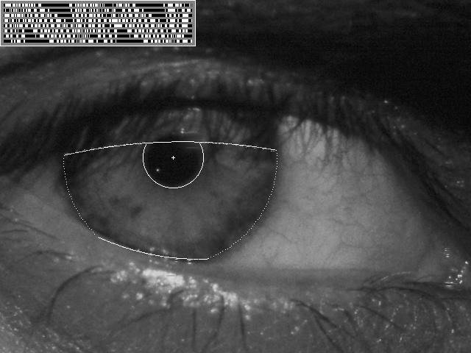
Vision-based biometrics
“How the Afghan Girl was Identified by Her Iris Patterns” Read the story wikipedia
Notes:
Age 12, Age 30

Slide 21
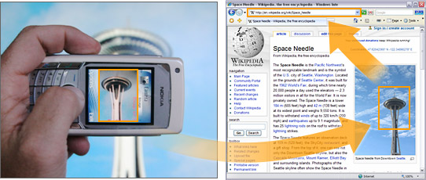
Object recognition (in mobile phones)
Point & Find, Nokia
Google Goggles

Slide 22
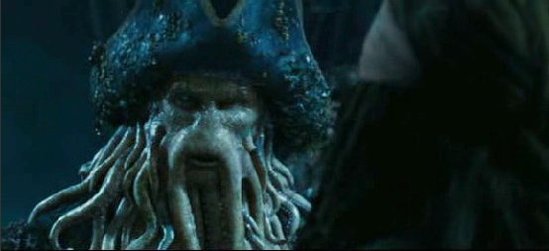
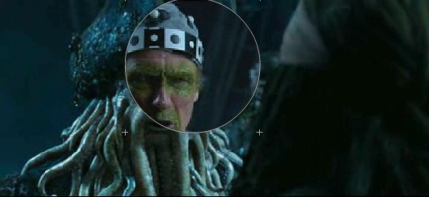
Special effects: motion capture
Pirates of the Carribean, Industrial Light and Magic

Slide 23
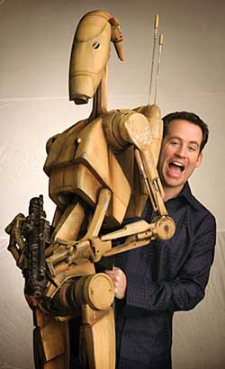
Steve Sullivan
Ph.D., UIUC, 1996
Head of R&D, ILM, 2003
Cover, IEEE Spectrum, 2004
CSO, Lucasfilm, 2009-2012
Microsoft (2013-)
3 Academy Awards

Slide 24
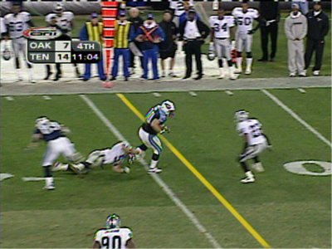
Sports
Sportvision first down line
Nice explanation on www.howstuffworks.com
http://www.sportvision.com/video.html

Slide 25
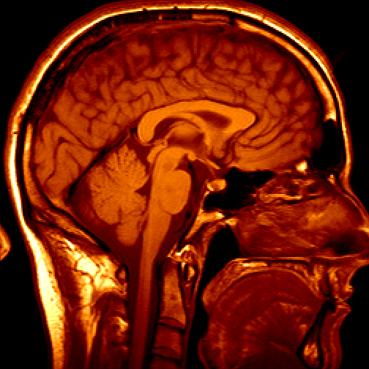
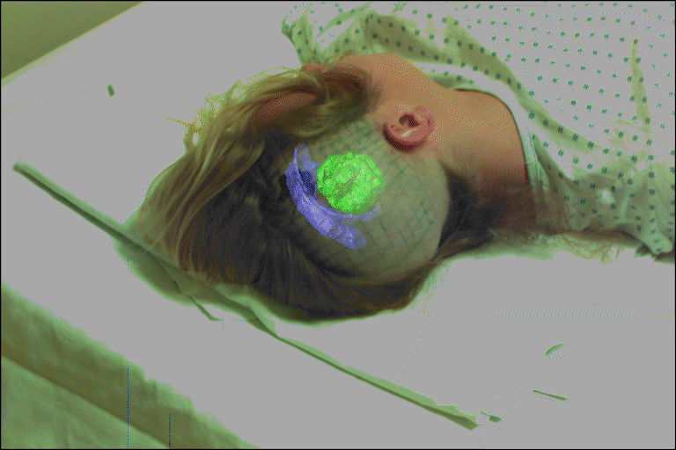
Medical imaging
3D imaging
MRI, CT
Image guided surgery
Grimson et al., MIT
Notes:
http://groups.csail.mit.edu/vision/medical-vision/surgery/surgical_navigation.html

Slide 26
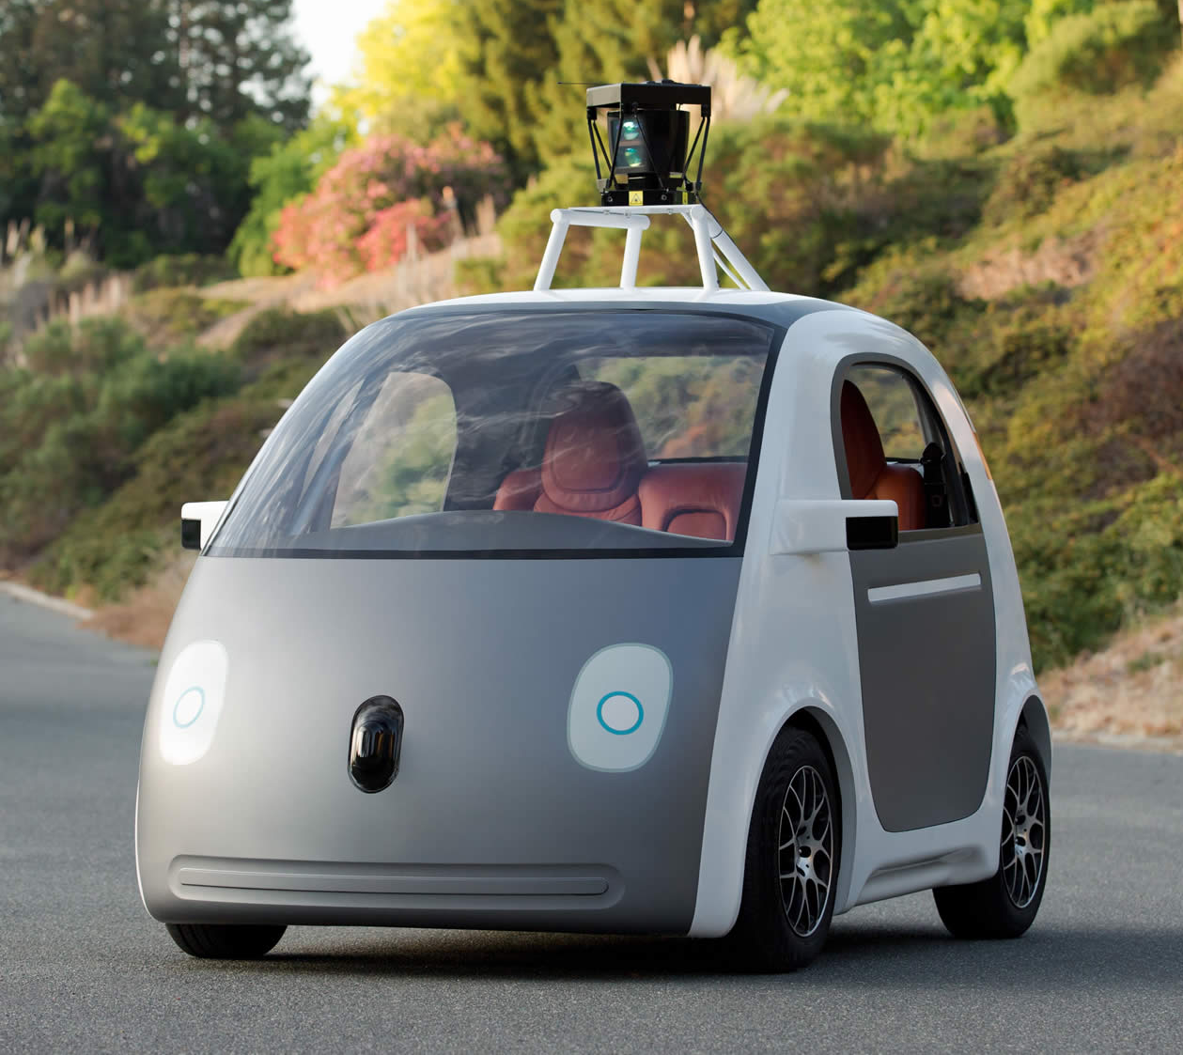
The Waymo autonomous car

Slide 27
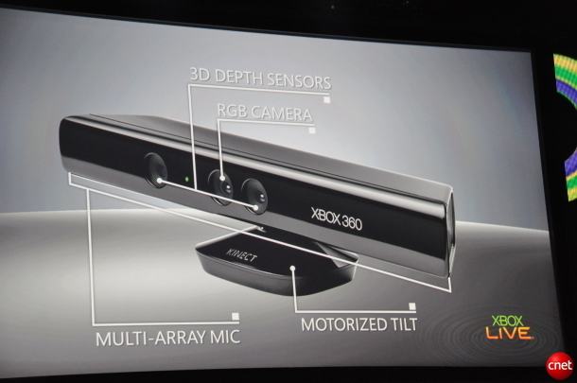
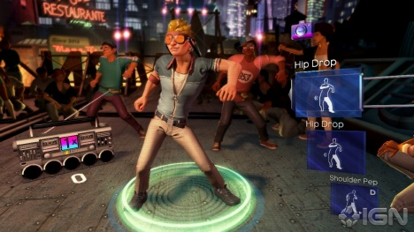
Interactive Games: Kinect
Object Recognition: http://www.youtube.com/watch?feature=iv&v=fQ59dXOo63o
Mario: http://www.youtube.com/watch?v=8CTJL5lUjHg
3D: http://www.youtube.com/watch?v=7QrnwoO1-8A
Robot: http://www.youtube.com/watch?v=w8BmgtMKFbY

Slide 28
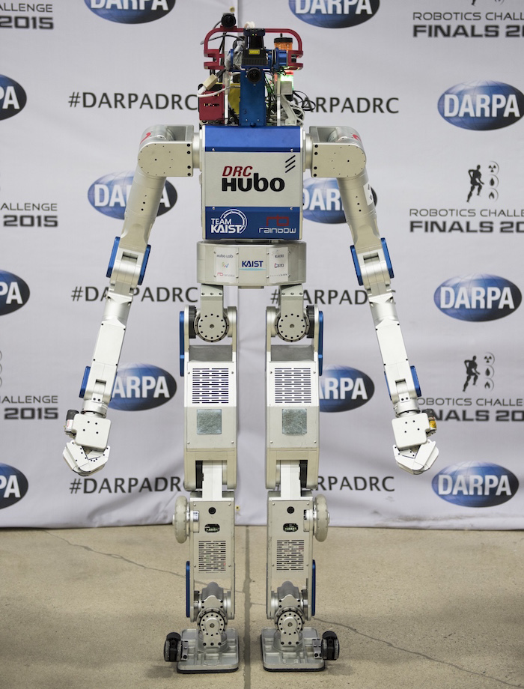
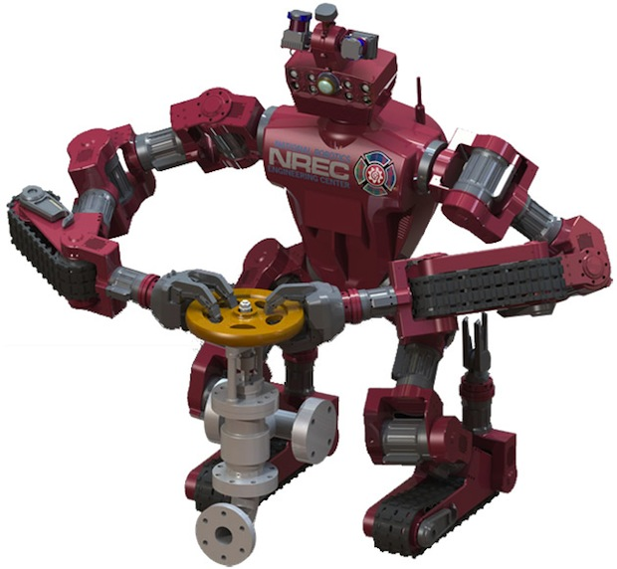
And robots of course
CMU’s Chimp
KAIST’s Hubo

Slide 29
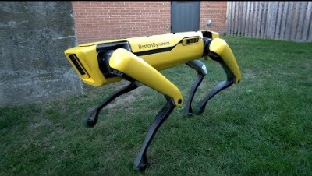
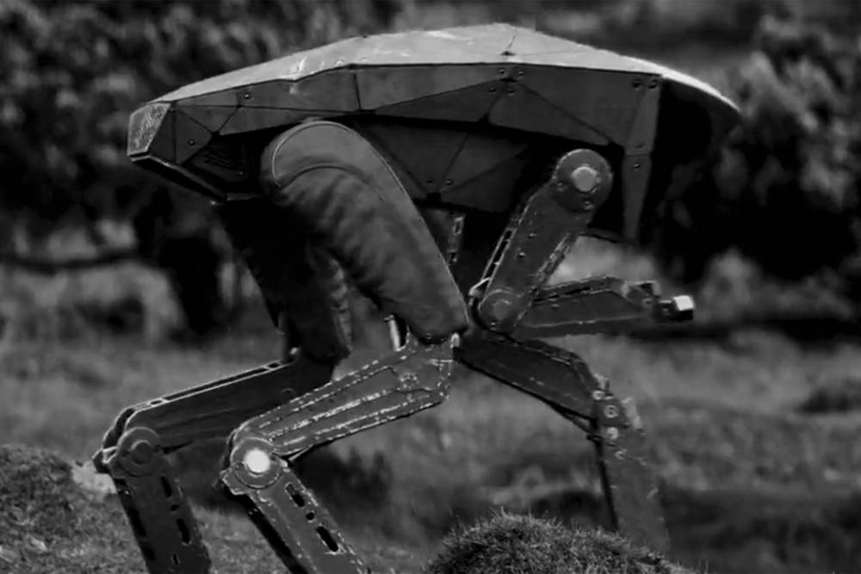
The SpotMini robot from Boston Dynamics
..and MetalHead from Black Mirror

Slide 30
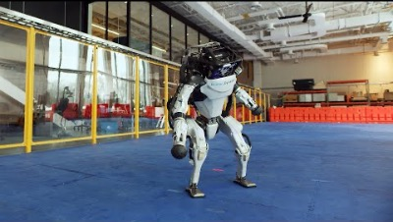
The Atlas robot from Boston Dynamics (1m80, 150kg)

Slide 31
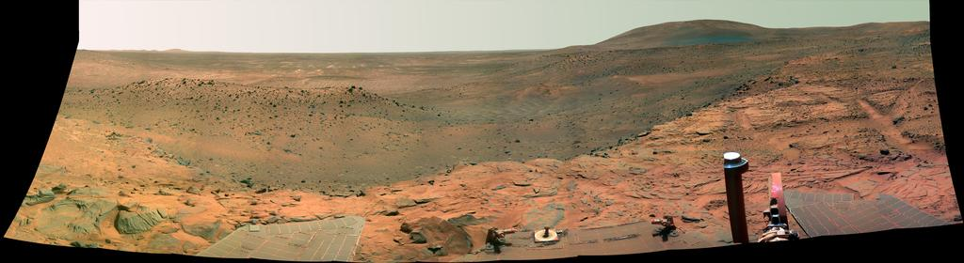
Vision in space
NASA'S Mars Exploration Rover Spirit captured this westward view from atop a low plateau where Spirit spent the closing months of 2007.
Vision systems (JPL) used for several tasks
Panorama stitching
3D terrain modeling
Obstacle detection, position tracking
For more, read “Computer Vision on Mars” by Matthies et al.

Slide 32
Computer vision books
D.A. Forsyth and J. Ponce, “Computer Vision: A Modern Approach”, Prentice-Hall, 2003, 2nd edition, 2011.
J.J. Koenderink, http://www.gestaltrevision.be/en/resources/clootcrans-press
M.F. Land and D.E. Nilsson, “Animal Eyes”, Oxford University Press, 2012.
R. Szeliski, “Computer Vision: Algorithms and Applications”, Springer, 2010.
O. Faugeras, Q.T. Luong, and T. Papadopoulo, “Geometry of Multiple Images,” MIT Press, 2001.
R. Hartley and A. Zisserman, “Multiple View Geometry in Computer Vision”, Cambridge University Press, 2004.

Slide 33
Course outline:
0. Introduction
Camera geometry and calibration
Filtering and feature detection
Radiometry and color
Texture and image segmentation
Stereopsis
Structure from motion and 3D models from images
Object recognition - historical perspective
CNNs for object classification and detection
3D CNNs and applications to medical imaging
Weakly-supervised and unsupervised approaches to image and video interpretation
Important note:
This class if about computer vision, not about
deep learning, pytorch, etc.

